Slide 1
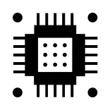





TAPIT
Engineering Co., Ltd.
STM32 MCU Programming Hybrid Learning Course
STM32 Analog-to-Digital Converter (ADC) – Part1
https://mculearning.com
Nơi học Vi điều khiển tốt nhất Việt Nam!
0981001119
https://tapit.vn
fb.com/tapitvn
contact@tapit.vn

Slide 2
ADC introduction (SAR type)
STM32
Cortex
M4
ADC_IN
SAR ADC
DMA
DATA
Memory
Analog to Digital Converter
Notes:
Analog signal
Digital signal

Slide 3
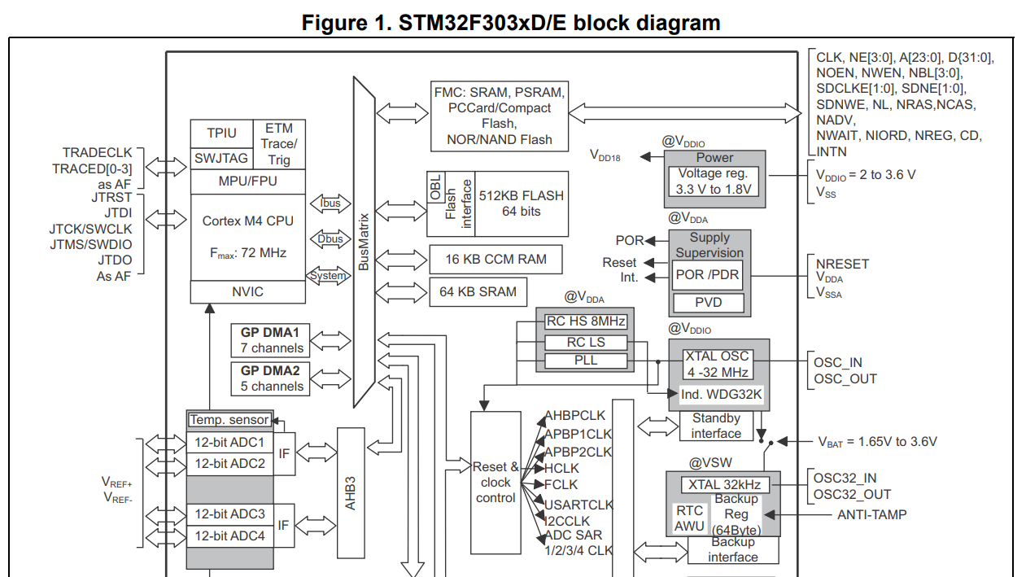
STM32F303RE ADC
Ref Datasheet: https://www.st.com/resource/en/datasheet/stm32f303re.pdf

Slide 4
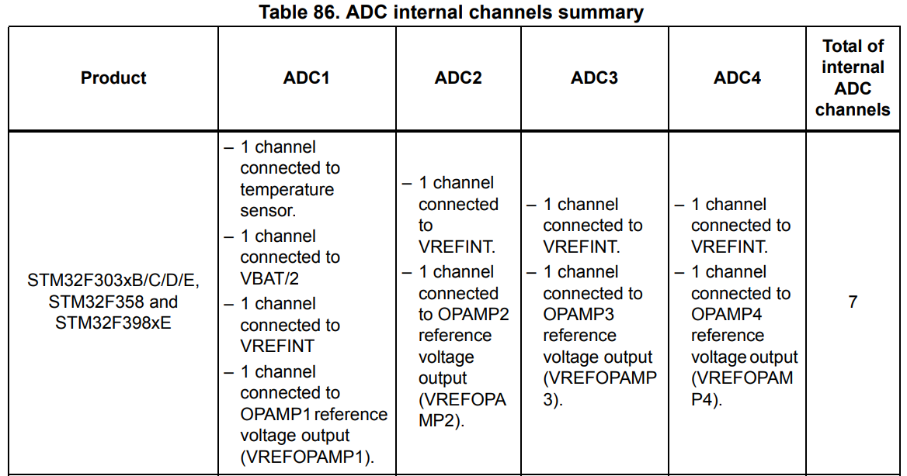
ADC CHANNEL
Each ADC has up to 19 multiplexed channels
External Channel
ADC external channels mapping:
Internal Channel
Ref User Manual: https://www.st.com/resource/en/reference_manual/dm00043574-stm32f303xb-c-d-e-stm32f303x6-8-stm32f328x8-stm32f358xc-stm32f398xe-advanced-arm-based-mcus-stmicroelectronics.pdf

Slide 5
ADC CHANNEL INPUT MODE
ADC channel inputs can be configured in single-ended or differential mode
Single-ended mode
A single-ended ADC measures the voltage an analog voltage signal on a single wire referenced to this common ground.
Differential mode
A differential ADC measures the voltage difference between two inputs.
Ref Differential and Single-Ended ADC: https://ww1.microchip.com/downloads/en/DeviceDoc/Differential-and-Single-Ended-ADC-WhitePaper-DS00003197A.pdf
Ref STM32F30x ADC modes and application:
https://www.st.com/resource/en/application_note/dm00069390-stm32f30x-adc-modes-and-application-stmicroelectronics.pdf

Slide 6
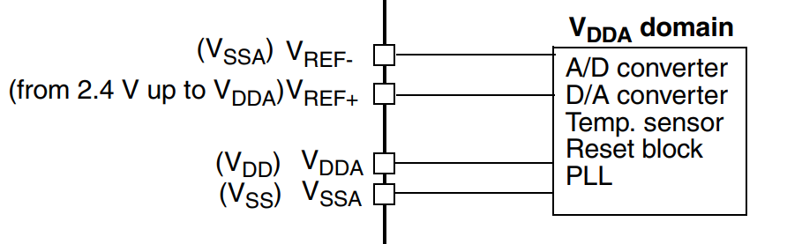
ADC RESOLUTION
12, 10, 8 or 6-bit configurable resolution
V_{IN} = V_{REF-} V_{IN} = V_{REF+}
N_{ADC} = 0 N_{ADC} = 2^{^12} -1
V_{REF-} ≤ V_{IN} ≤ V_{REF+}
0 ≤ N_{ADC} ≤ 2^{^12} -1
V_{IN} – V_{REF-}
N_{ADC} x VDD
N_{ADC} = (2^{^12} -1) x
V_{IN}
=
V_{REF+} – V_{REF-}
4095
*16bit data register -> DataAlignment (right alignment)

Slide 7
STM32F30x ADC modes
Independent modes
Regular conversion mode
Injected conversion mode
Dual modes
Dual injected simultaneous mode
Dual regular simultaneous mode
Dual interleaved mode
Dual alternate trigger mode
Ref STM32F30x ADC modes and application: https://www.st.com/resource/en/application_note/dm00069390-stm32f30x-adc-modes-and-application-stmicroelectronics.pdf

Slide 8
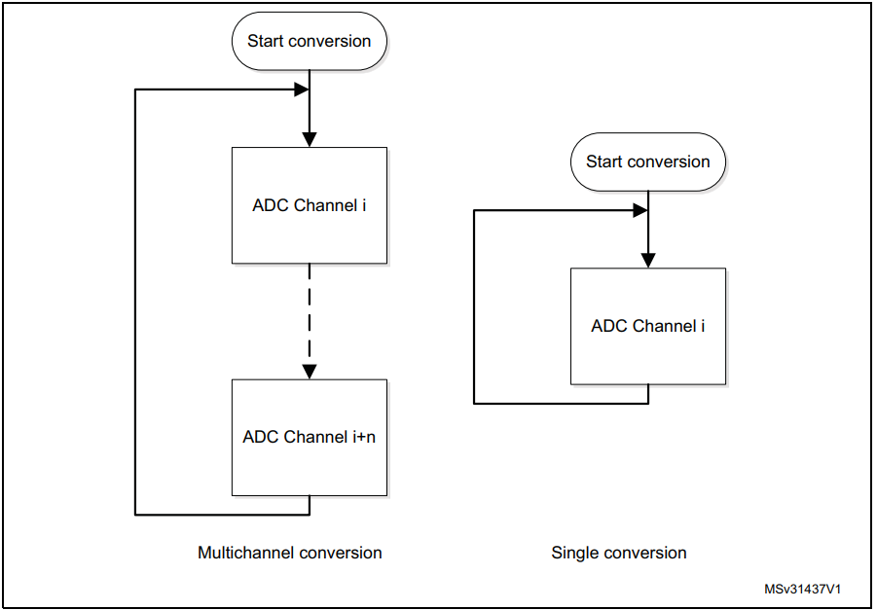
STM32F30x ADC modes
Independent modes
Regular conversion mode
Multichannel/Single, continuous mode

Slide 9
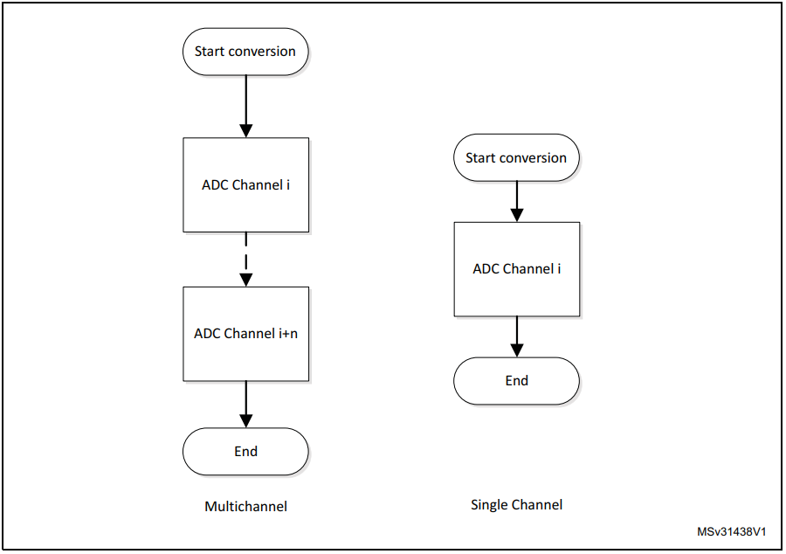
STM32F30x ADC modes
Independent modes
Regular conversion mode
Multichannel/single, single conversion mode

Slide 10
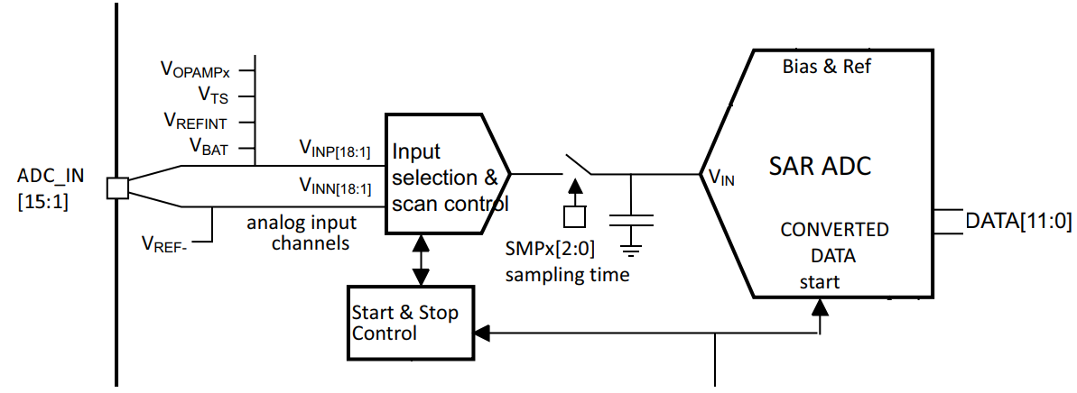
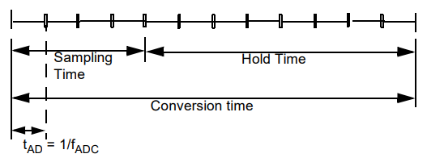
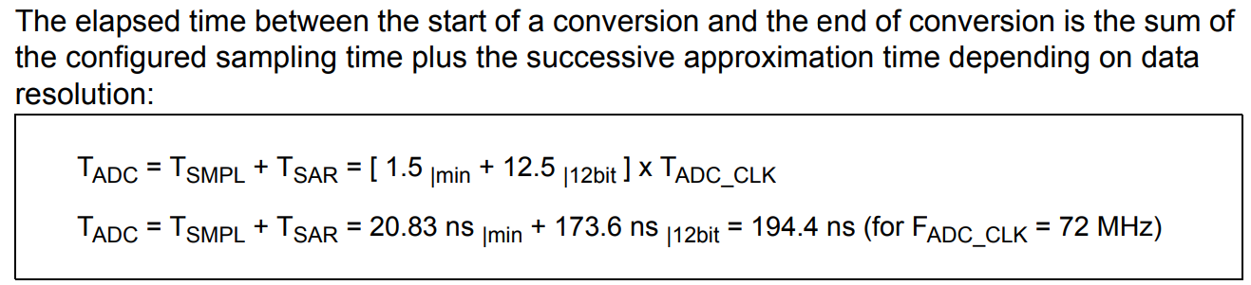
ADC SAMPLING TIME
Ref User manual: https://www.st.com/resource/en/reference_manual/dm00043574-stm32f303xb-c-d-e-stm32f303x6-8-stm32f328x8-stm32f358xc-stm32f398xe-advanced-arm-based-mcus-stmicroelectronics.pdf

Slide 11
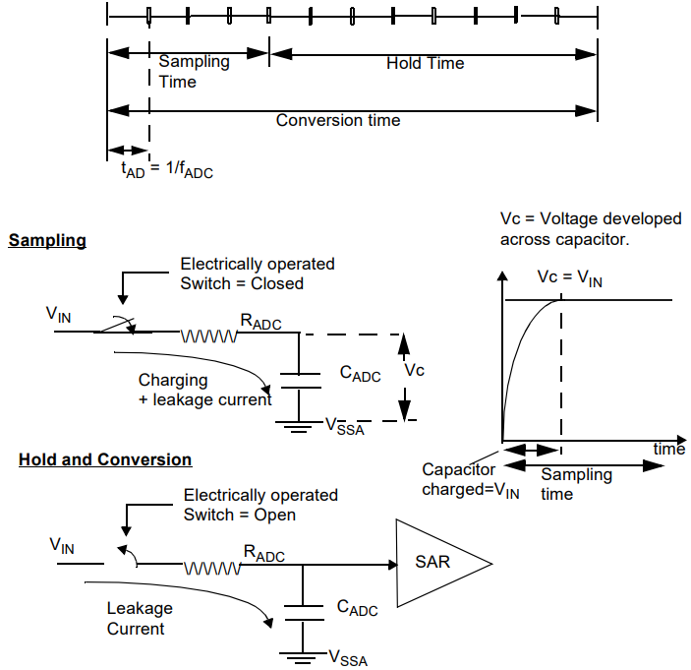
ADC SAMPLING TIME

Slide 12
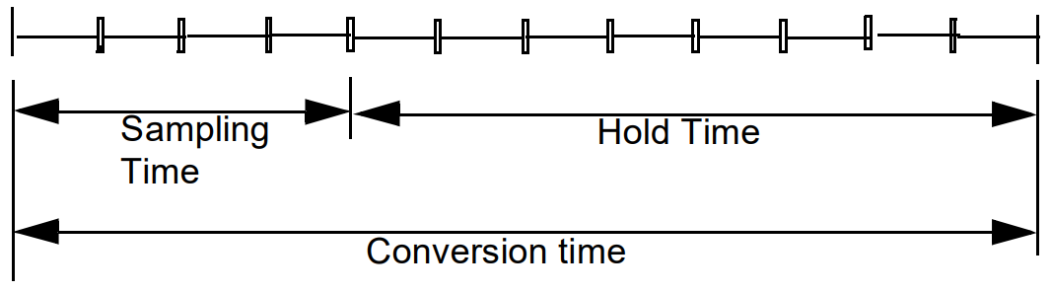
Get ADC Value
Polling
HAL_ADC_Start(ADC_HandleTypeDef* hadc)
HAL_ADC_PollForConversion(ADC_HandleTypeDef* hadc, uint32_t Timeout) uint32_t HAL_ADC_GetValue(ADC_HandleTypeDef* hadc)
HAL_ADC_Stop(ADC_HandleTypeDef* hadc)
Interrupt generation at End of Conversion, End of Injected
HAL_ADC_Start_IT(ADC_HandleTypeDef* hadc)
HAL_ADC_Stop_IT(ADC_HandleTypeDef* hadc)
DMA request generation during regular channel conversion
HAL_ADC_Start_DMA(ADC_HandleTypeDef* hadc, uint32_t* pData, uint32_t Length)
HAL_ADC_Stop_DMA(ADC_HandleTypeDef* hadc)
void HAL_ADC_ConvCpltCallback(ADC_HandleTypeDef* hadc) {
….. HAL_ADC_GetValue…
}

Slide 13

ADC Poll lab
How to setup ADC in poll in CubeMX and Generate Code
How to Generate Code in CubeMX and use HAL functions

Slide 14
Use ADC in polling mode
HAL_ADC_Start(DAC_HandleTypeDef* hdac, uint32_t Channel) HAL_ADC_PollForConversion(ADC_HandleTypeDef* hadc, uint32_t Timeout)
HAL_ADC_GetValue(ADC_HandleTypeDef* hadc)

Slide 15
Use ADC in polling mode
/* USER CODE BEGIN PV */
uint32_t value_adc;
/* USER CODE END PV */
/* USER CODE BEGIN 3 */
/* Infinite loop */
while (1)
{
HAL_ADC_Start(&hadc1); HAL_ADC_PollForConversion(&hadc1,10); value_adc=HAL_ADC_GetValue(&hadc1);
HAL_Delay(1000);
}
/* USER CODE END 3 */
=>Debug

Slide 16
ADC Interrupt lab
How to setup ADC in interrupt in CubeMX and Generate Code
How to Generate Code in CubeMX and use HAL functions

Slide 17
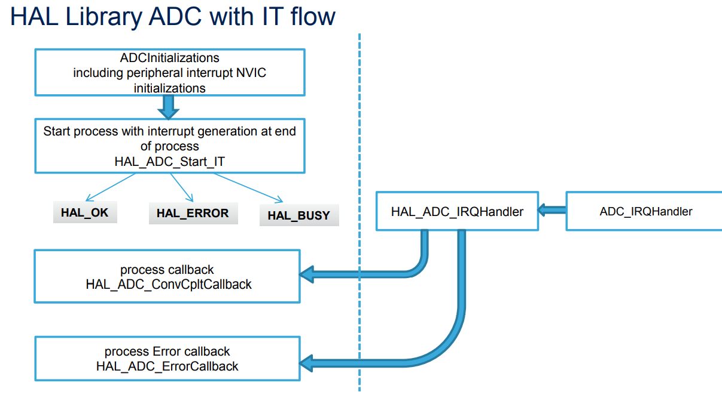
TAB>NVIC settings
Use ADC with interrupt

Slide 18
Use ADC with interrupt
For ADC start use function
• HAL_ADC_Start_IT(ADC_HandleTypeDef* hadc, uint32_t Channel)
• HAL_ADC_GetValue(ADC_HandleTypeDef* hadc)
ADC complete callback function
• HAL_ADC_ConvCpltCallback(ADC_HandleTypeDef* hadc)

Slide 19
Use ADC with interrupt
/* USER CODE BEGIN PV */
uint32_t value_adc;
/* USER CODE END PV *
/* USER CODE BEGIN 2 */
HAL_ADC_Start_IT(&hadc1);
/* USER CODE END 2 */
/* USER CODE BEGIN 4 */
void HAL_ADC_ConvCpltCallback(ADC_HandleTypeDef* hadc)
{
value_adc=HAL_ADC_GetValue(&hadc1);
HAL_ADC_Start_IT(&hadc1);
}
/* USER CODE END 4 */
=>Debug

Slide 20



TAPIT
Engineering Co., Ltd.
Instructor
Eng. Nguyen Huynh Nhat Thuong Eng. Tran Thuy Ngoc Hang
0981001119
https://tapit.vn
fb.com/tapitvn
contact@tapit.vn
Notes:
Cảm ơn các bạn.

